Slide 1
CHAPTER 2 Generalised Predictive Control 12 Independent model GPC
Anthony Rossiter

Slide 2
Background
So far this chapter has given GPC based on CARIMA and state space models and DMC, which is equivalent to GPC with a step response model.
One widely used alternative in the literature is the so called independent model.
Independent models have the advantage of having the same sensitivity, irrespective of whether they are state-space or transfer function and in simple terms are based primarily on input information with minimal use of measured outputs to form predictions.

Slide 3
Independent model structure
A model is simulated in parallel with the real process.
Predictions are based on the model input/output and the offset term (see video 10 of chapter 1).

Slide 4
Summary of unbiased predictions
A common tool to ensure unbiased predictions is the use of a disturbance estimate or offset term ‘d’.
This term captures both the actual system disturbance and caters for any errors in the parameters.
Predictions using model alone
Offset term
Process output
Model output
Predictions using model and offset term

Slide 5
Predictions with an independent model
The underlying model can be transfer function or state space (or indeed other forms).
Outputs and states are for the independent model and therefore are known exactly.

Slide 6
IM GPC with TF predictions
Substituting predictions into J gives the following:

Slide 7
Expanding GPC law
A GPC control law is summarised as.
We can unpack each of these terms in more detail.

Slide 8
Block diagram
In more compact form it is easy to show (using same steps as video 2_3)

Slide 9
MATLAB code
Some code for doing independent model GPC is provided (noise rejection equivalent to DMC).
OBSERVATION
Less sensitive to measurement noise than CARIMA based GPC.
NO need for a T-filter!
Figures from video2_12_example1.m

Slide 10
Disturbance rejection
For this example, IMGPC is worse
IMGPC
GPC

Slide 11
IMGPC with SS predictions
The nominal state space predictions can be written as:
A possible unbiased cost (the literature does contain variants which use input increments):
The steady-state input needs to be estimated:

Slide 12
Remark on H
Implicit that input predictions are at steady-state, and remain so, after n_{u} samples.
NOTE:
This is a d.o.f. each sample.

Slide 13
IM GPC with SS predictions
Substituting predictions into J gives the following:

Slide 14
IM GPC with SS predictions
The control law reduces to (no advance target):

Slide 15
MATLAB code
Code is provided to simulate independent model based GPC using a state space model.
WARNING: We have made a different choice of performance index and thus this will not give the same responses as TF based GPC.
Write your own code to use an equivalent J! This means expressing predictions in terms of control increments.
To edit for a MIMO example, remember to update reference signals as well
video2_12_example2.m

Slide 16
Summary
IMGPC uses predictions based solely on model inputs/outputs and corrects with an offset term.
This de-sensitises predictions to measurement noise, but may be worse at rejecting disturbances.
Coding is almost identical to GPC using the same model format; the only difference is how the control action depends upon the measured offset, e.g.:

Slide 17
REMARKS
It can be shown that CARIMA based IMGPC is equivalent to DMC as both base predictions solely on past inputs and a linear model, using the offset to correct for any bias.
IMGPC is easier than DMC because predicting with TF/SS models is quicker/easier than using step response models.
IMGPC can also be used with SS models and in this case no observer is used but rather just output feedback. (The independent model is acting liking the observer.)

Slide 18



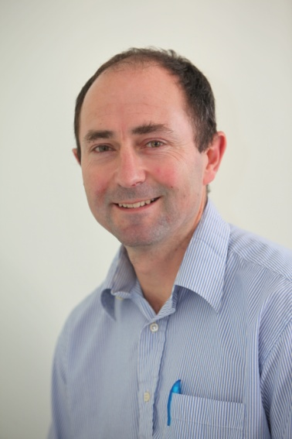
Anthony Rossiter
Department of Automatic Control and Systems Engineering
University of Sheffield
www.shef.ac.uk/acse
© 2014 University of Sheffield
This work is licensed under the Creative Commons Attribution 2.0 UK: England & Wales Licence. To view a copy of this licence, visit http://creativecommons.org/licenses/by/2.0/uk/ or send a letter to: Creative Commons, 171 Second Street, Suite 300, San Francisco, California 94105, USA.
It should be noted that some of the materials contained within this resource are subject to third party rights and any copyright notices must remain with these materials in the event of reuse or repurposing.
If there are third party images within the resource please do not remove or alter any of the copyright notices or website details shown below the image.
(Please list details of the third party rights contained within this work.
If you include your institutions logo on the cover please include reference to the fact that it is a trade mark and all copyright in that image is reserved.)

